Slide 1
PRESENTED BY: OLOYADE WAKILU Online Payment Fraud Detection
FINAL PROJECT
Case Study: Blossom Bank
Submitted To:
10Alytics

Slide 2
INTRODUCTION
Blossom Bank:
a multinational financial services group, that offers retail and investment banking, pension management, asset management and payments services, headquartered in London, UK.

Slide 3
PROBLEM
Blossom Bank wants to build a Machine Learning model to predict online payment fraud
The data set contains fraudulent transactions.
OBJECTIVE
Improve the financial fraud detection system by building a machine learning model and identifying the best machine learning model to predict online payment fraud.

Slide 4
DATA ANALYTICS STEPS
COLLECT DATA
CLEAN DATA
ANALYZE DATA
INTERPRET RESULTS
Data set from Blossom bank
Exploration
Transformation
Modeling
Prediction
Evaluation

Slide 5
DATA SET
The dataset consists of a list of 1,048,575 customer transaction. The list cuts across different transaction types like cash-out, transfer, payment, cash-in, and debit.
Several feature indicators were used, these are: step, type, amount, nameorig, newbalanceorg etc.
The below column reference:
• step: represents a unit of time where 1 step equals 1 hour
• type: type of online transaction
• amount: the amount of the transaction
• nameOrig: customer starting the transaction
• oldbalanceOrg: balance before the transaction
• newbalanceOrig: balance after the transaction
• nameDest: recipient of the transaction
• oldbalanceDest: initial balance of recipient before the transaction
• newbalanceDest: the new balance of the recipient after the transaction
• isFraud: fraud transaction.

Slide 6
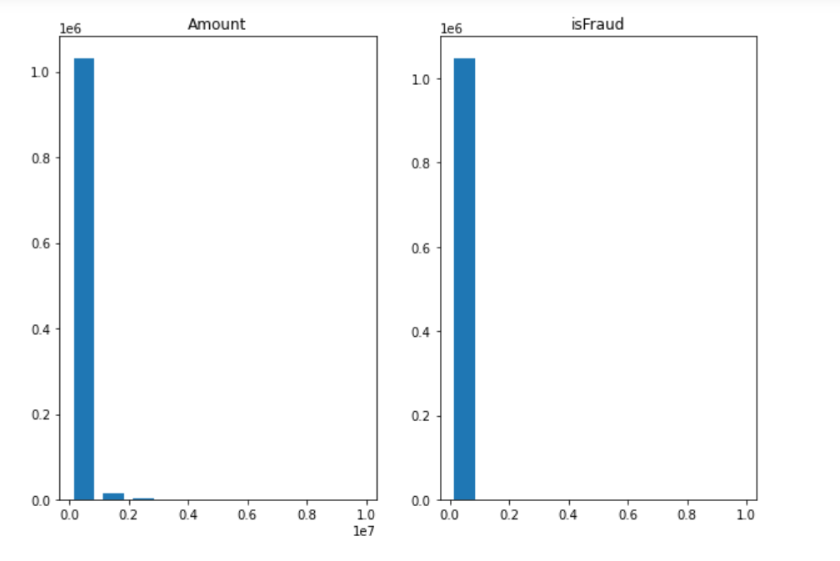
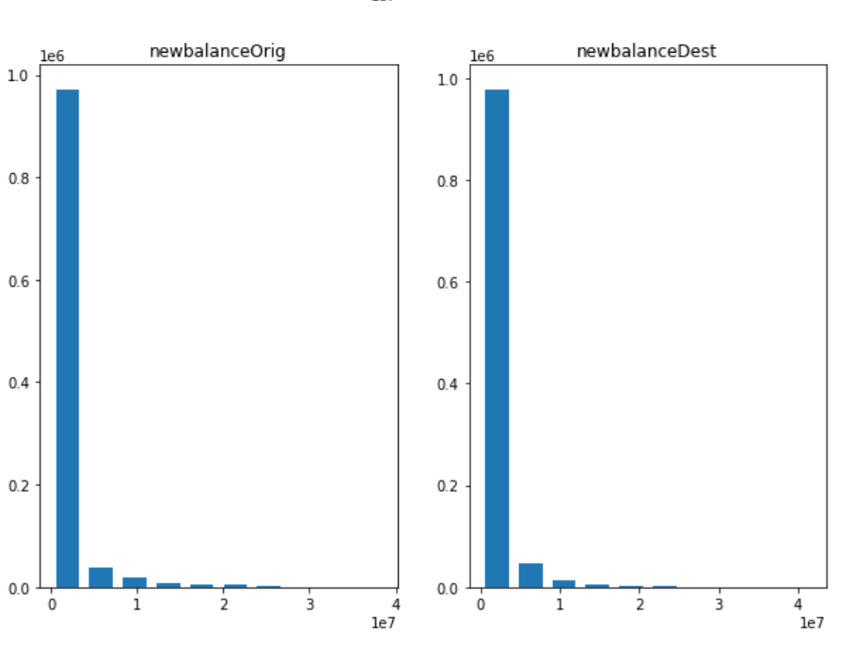
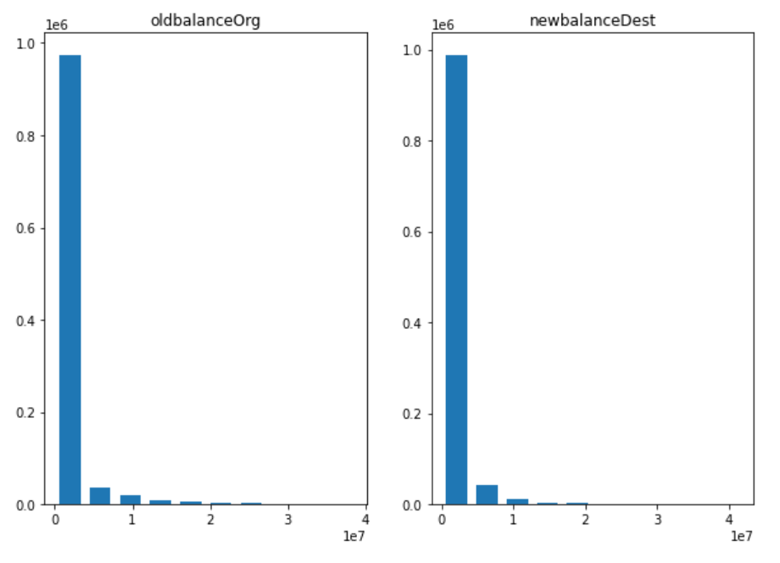
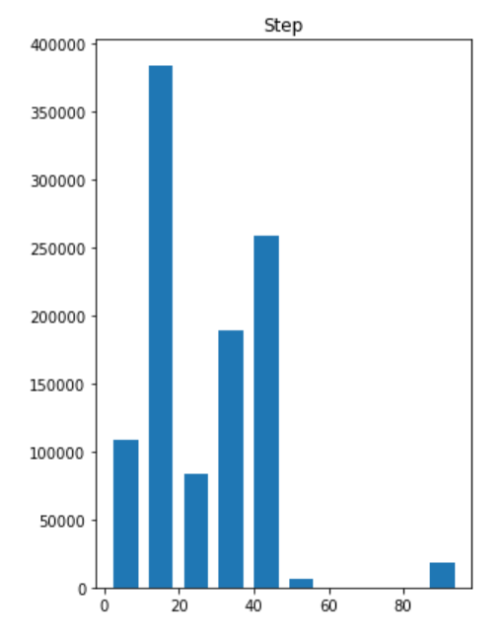
VISUALIZATION
First Sight Analysis (Distribution of numeric variable)
1,048,575
Observations/Rows
10
Features/Columns
0
Missing values
1,142
Fraudulent transactions

Slide 7
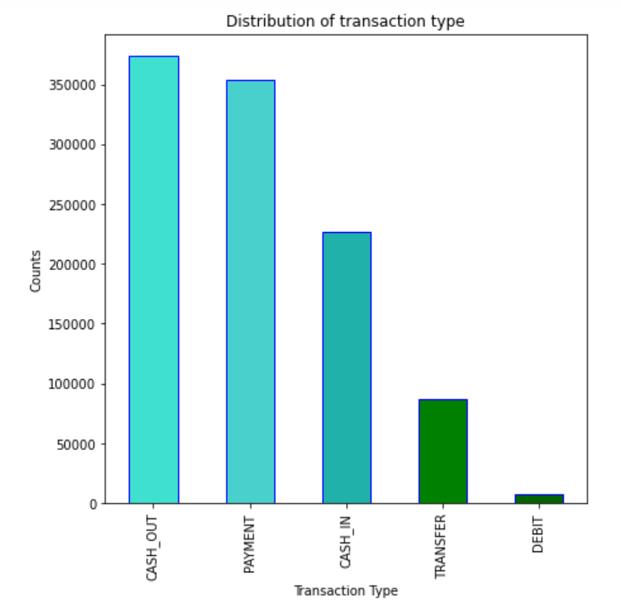
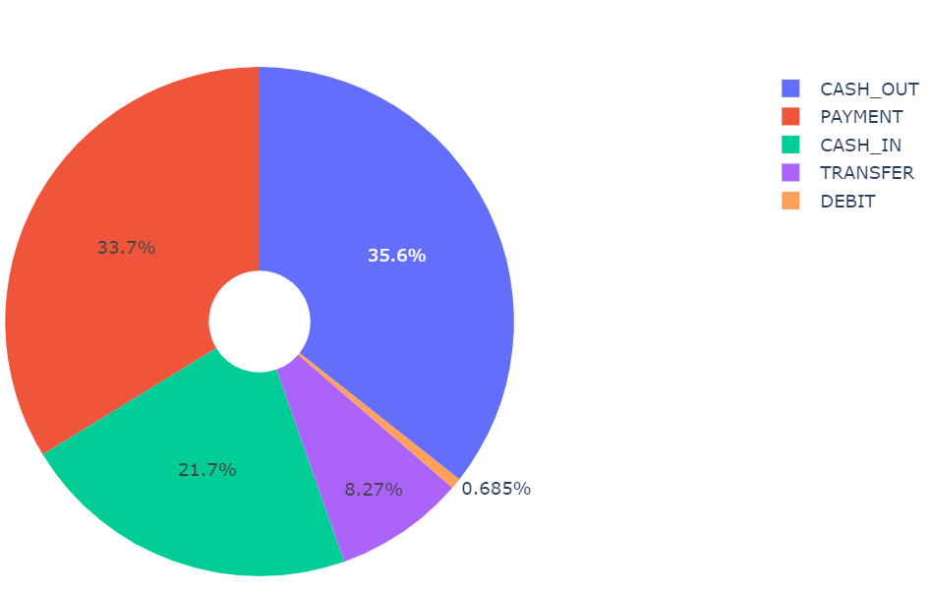

Slide 8
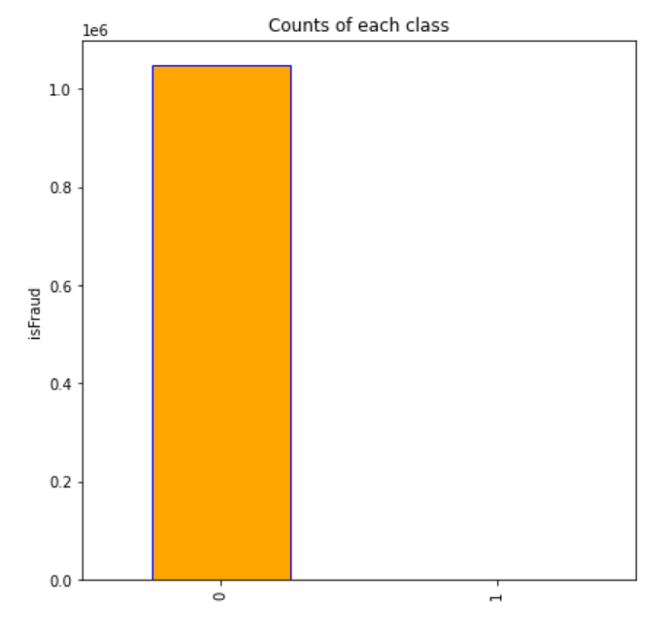
Counts of each class on the target column
Valid (not fraud):
99% (1,047,433 cases)
Fraud:
1% (1,142 cases)

Slide 9
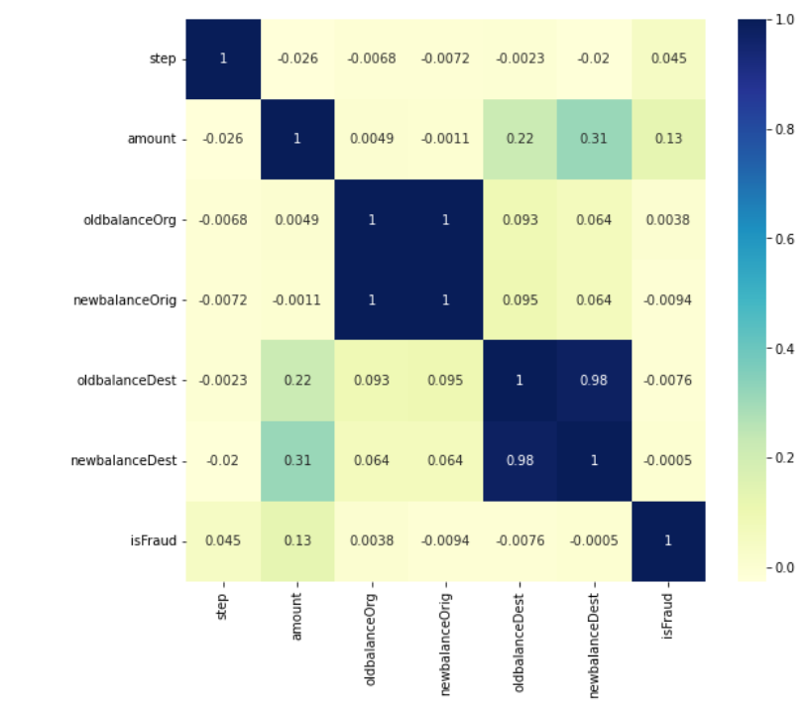
Column Name | r
Amount | 0.13
Step | 0.045
OldbalanceOrg | 0.0038
NewbalanceDest | -0.0005
OldbalanceDest | -0.0076
NewbalanceOrig | -0.0094
Low linear correlation with the target

Slide 10
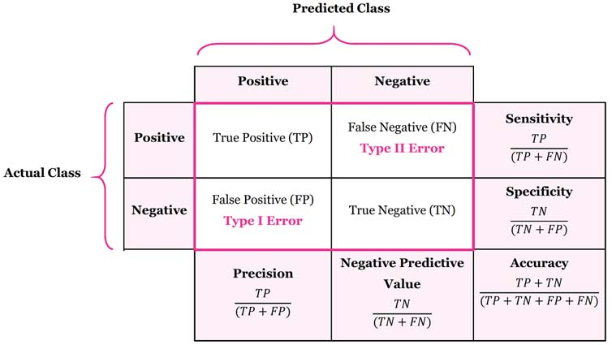
CLASSIFICATION
Target: is it fraud Operation?
Features: relevant Columns
Figure: Confusion Matrix
Figure Source:
https://rapidminer.com/glossary/confusion-matrix/

Slide 11
MODELING
Logistic Regression
Random Forest
Decision Tree

Slide 12
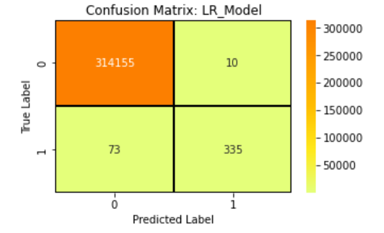
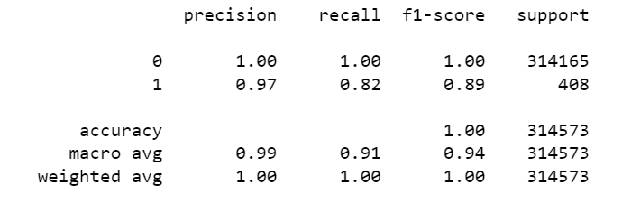
Logistic Regression
Confusion Matrix
Classification Report
Accuracy: 99%

Slide 13
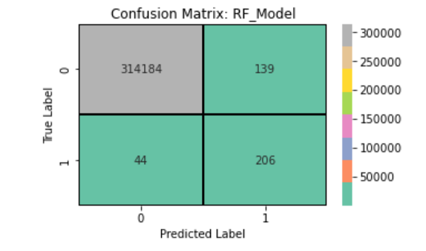
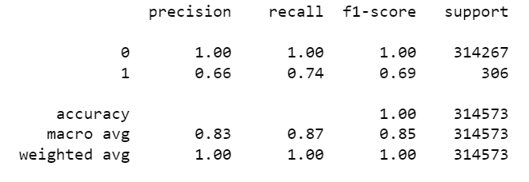
Random Forest
Confusion Matrix
Classification Report
Accuracy: 99%

Slide 14
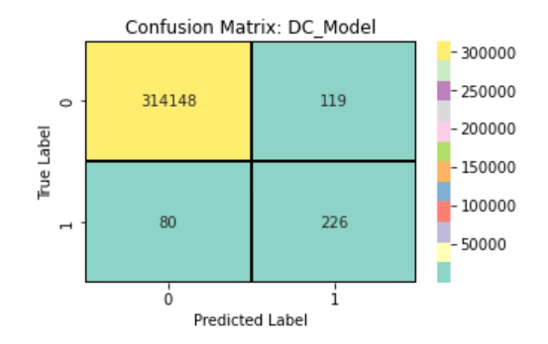
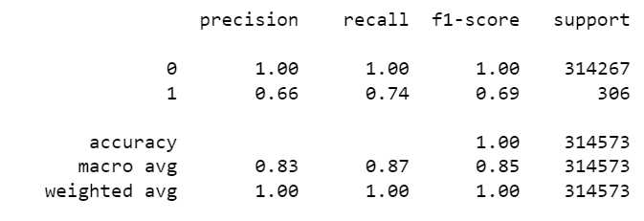
Decision Tree
Confusion Matrix
Classification Report
Accuracy: 99%

Slide 15
CONCLUSION
Note: One of the important points of doing this project is to identify two things.
Which matrix should be looking at?
Which model do they work perfectly for the problem?
In this case, I want the higher recall because it actually covers the highest number of fraud cases. So logistic regression is the best model that fits this problem.

Slide 16
THANK YOU

